Slide 1


Strategic Insights and Recommendations for AtliQ Hardware
Anshika Porwal
Data Analyst

Slide 2
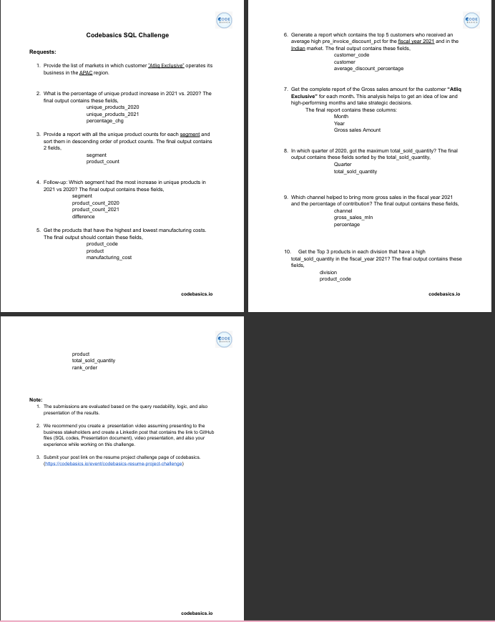

Slide 3
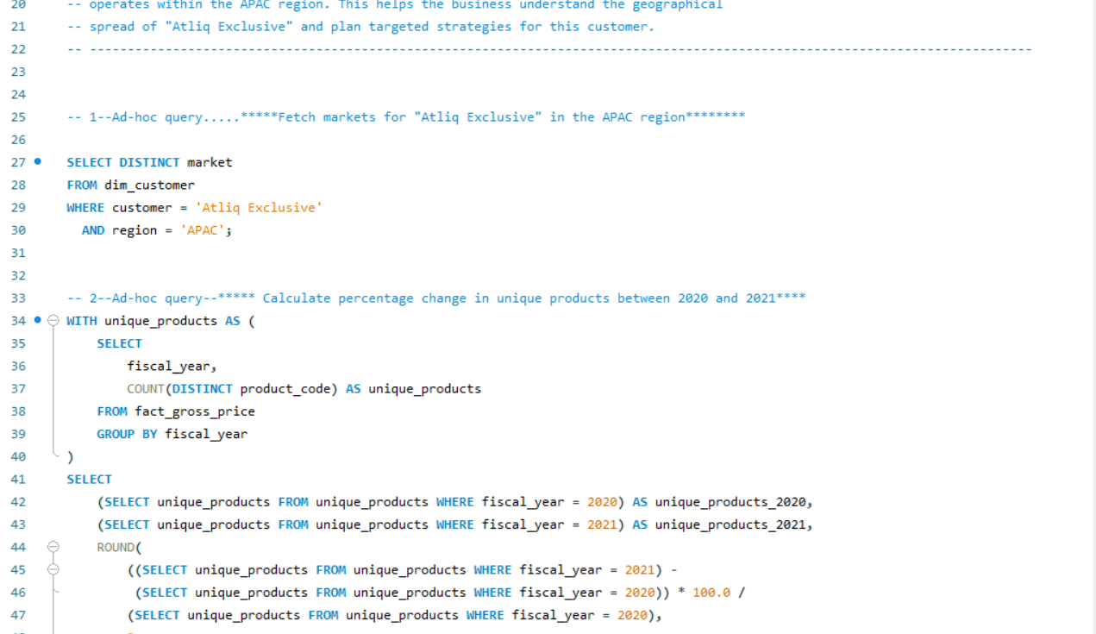

Slide 4
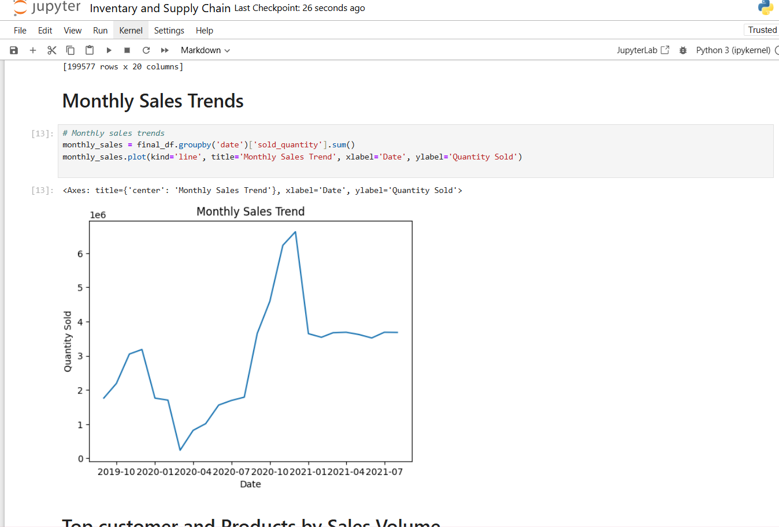

Slide 5
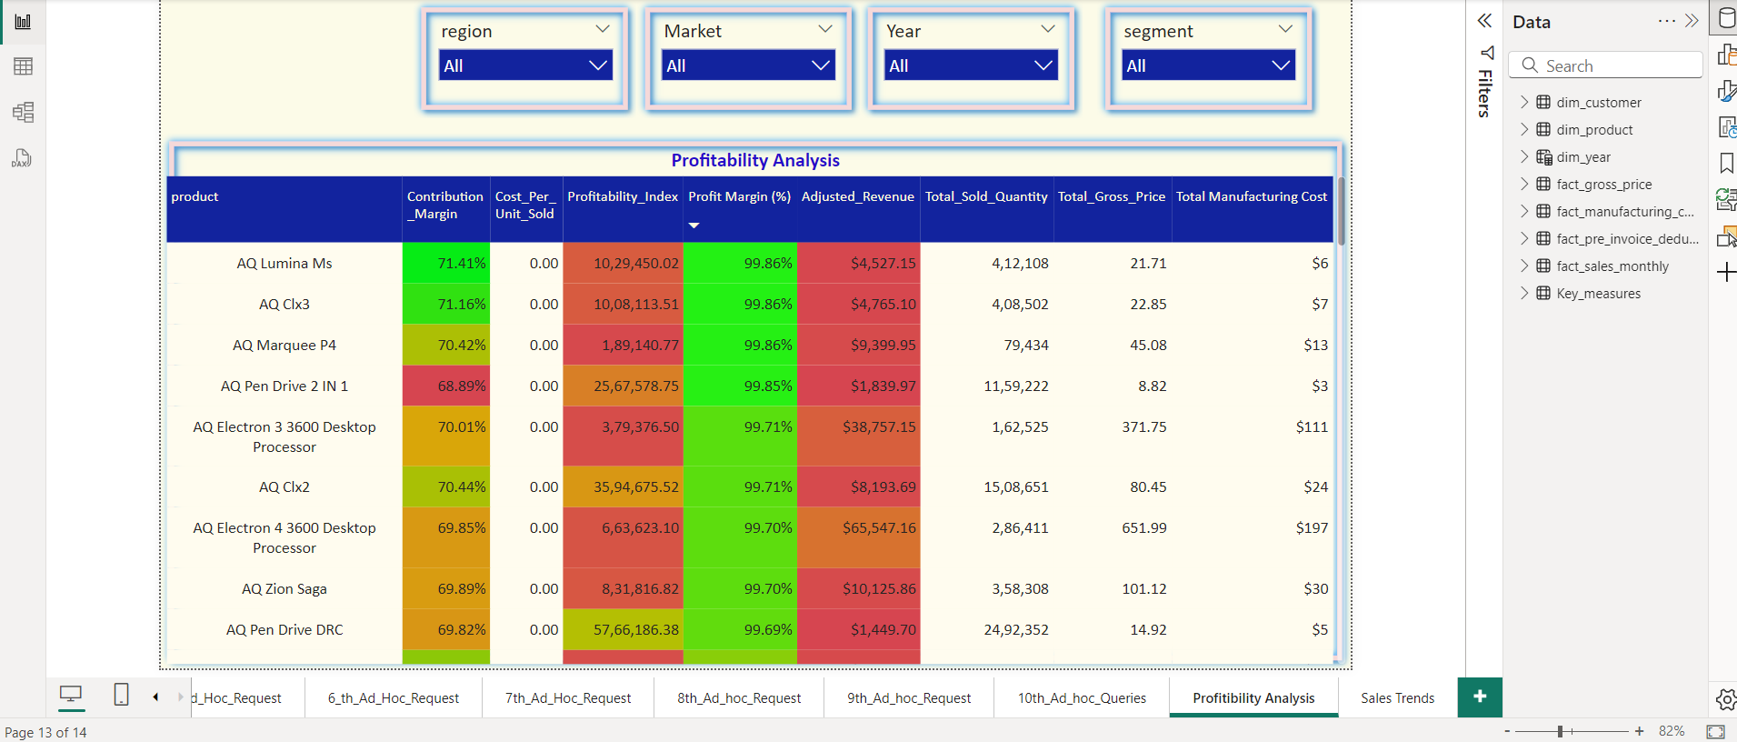

Slide 6
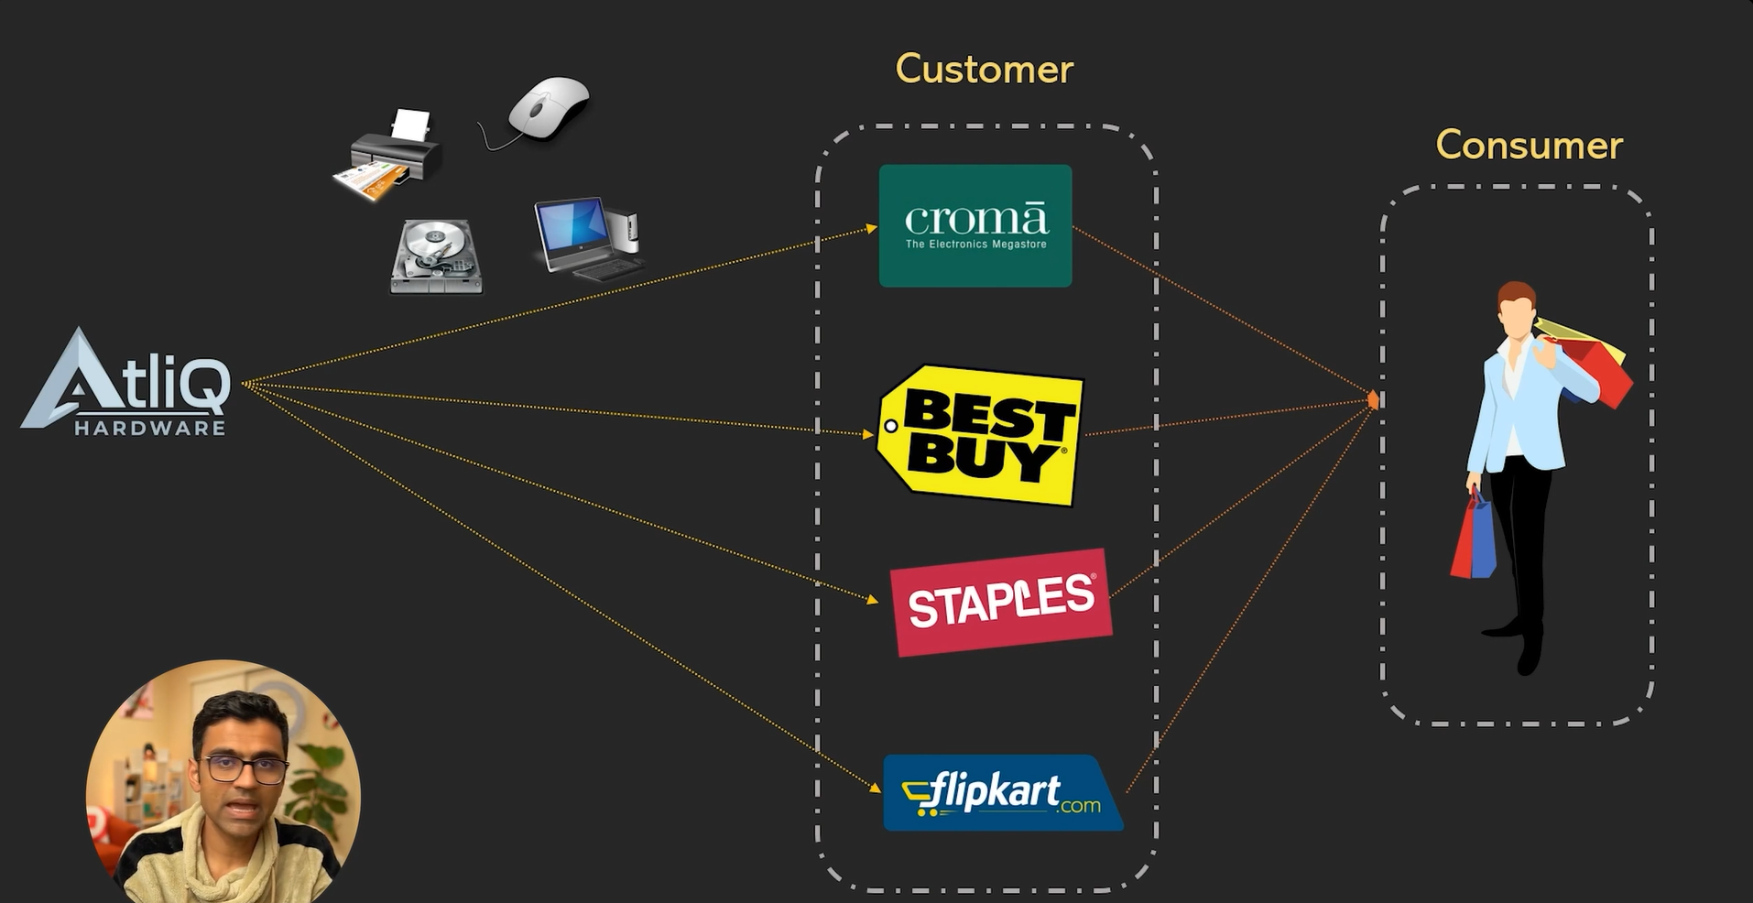

Slide 7
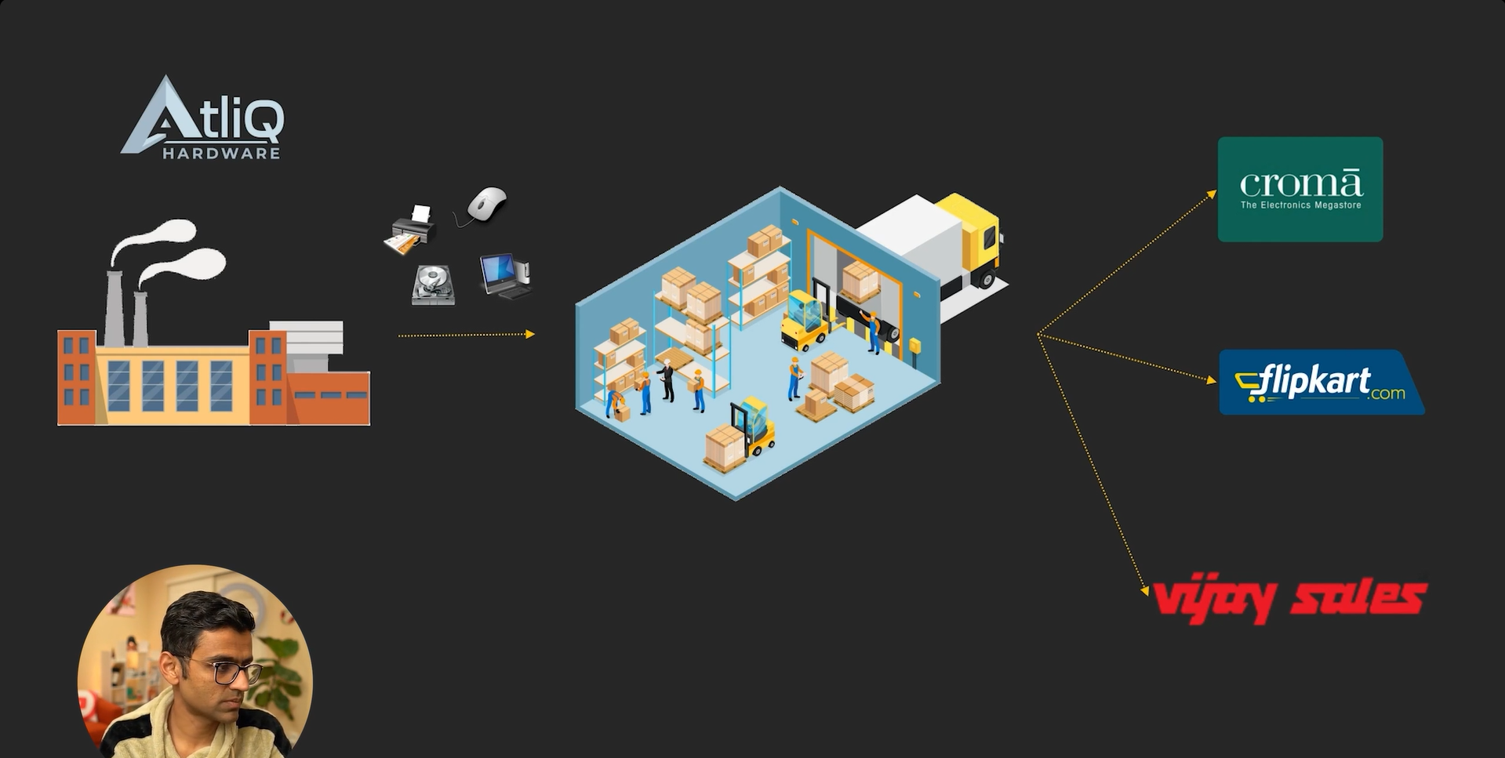

Slide 8
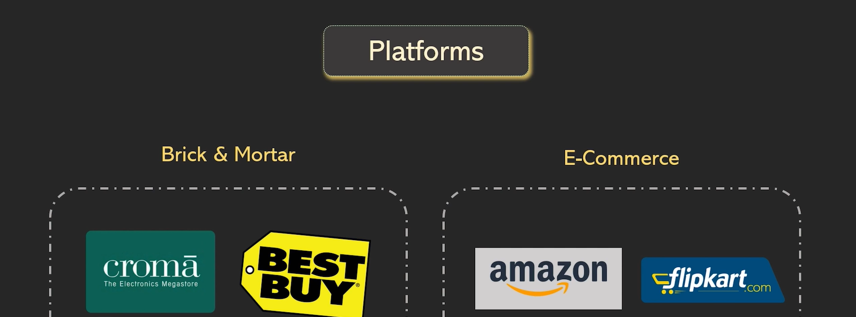

Slide 9
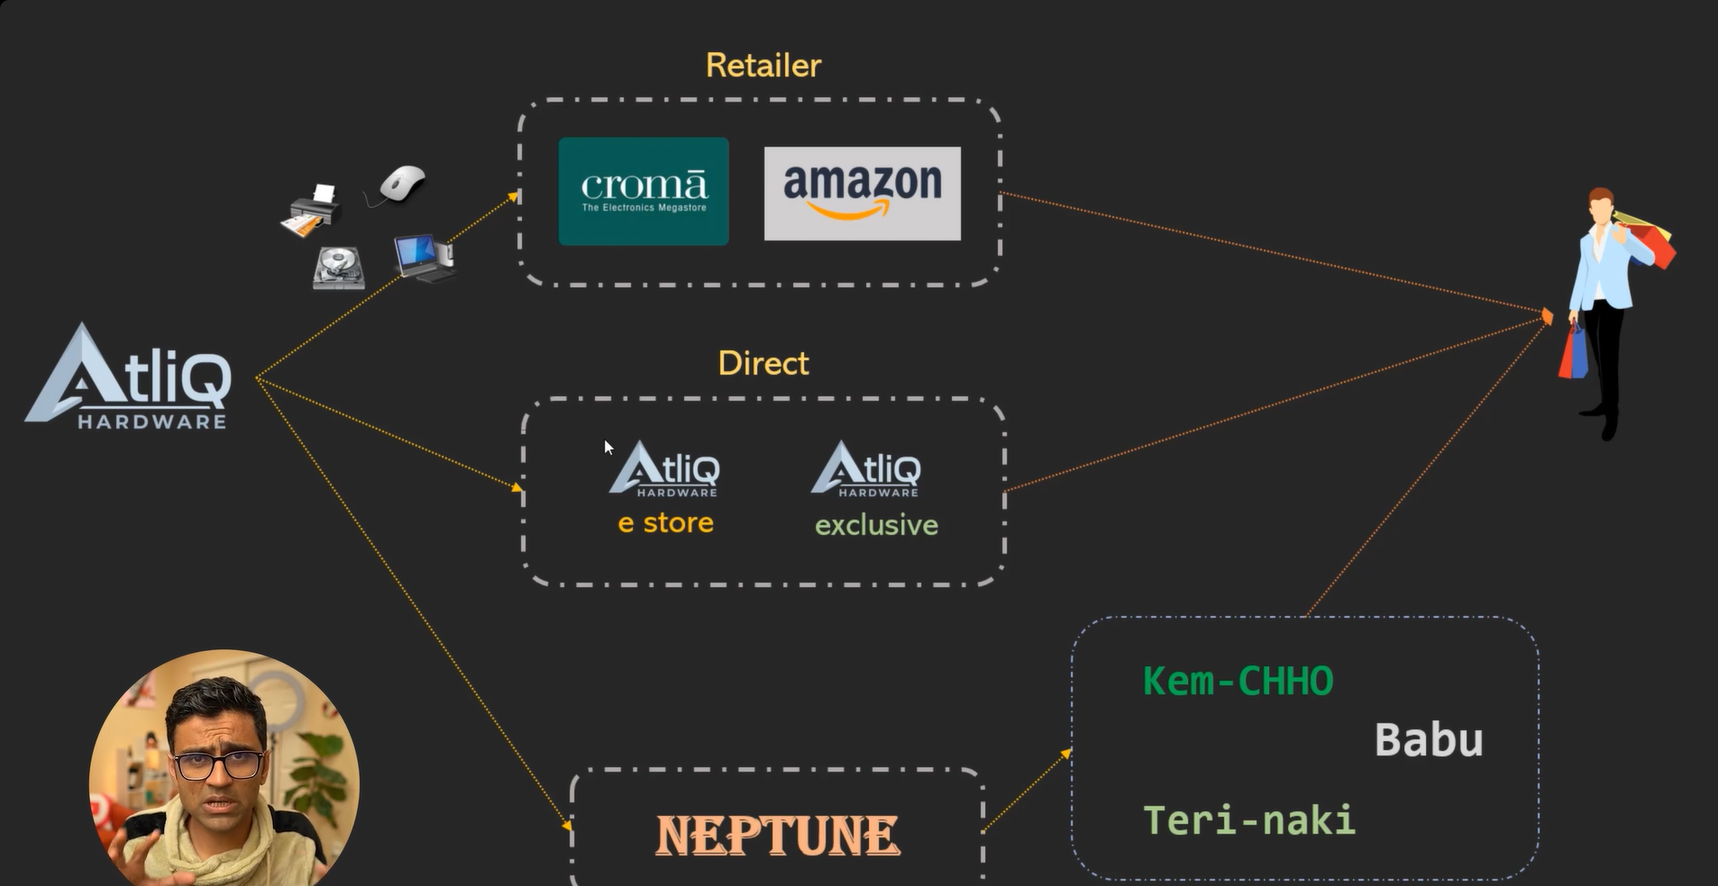

Slide 10
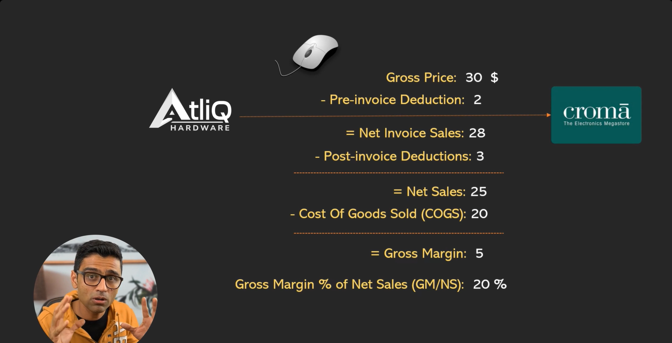

Slide 11

Objective
Data-Driven Decisions
01
Utilize Insights from sales and product data analytics to make informed decision that enhance market strategy and product offering across all the region
Performance Optimization
02
Implement strategies based on identified trends in customer behaviour and sales performance to improve operational efficiency and profitability in diverse markets.

Slide 12
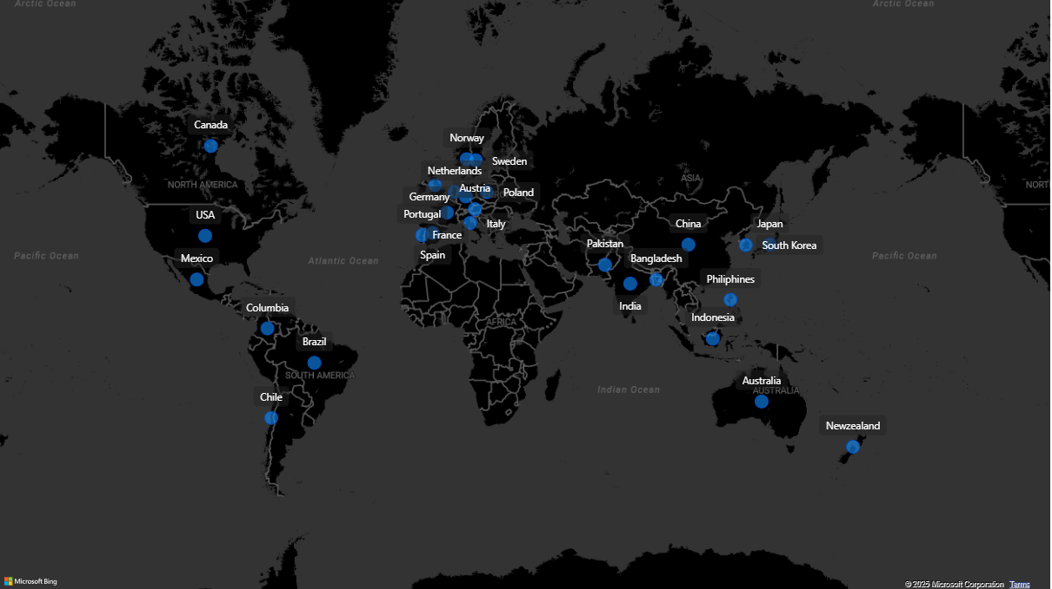

Slide 13
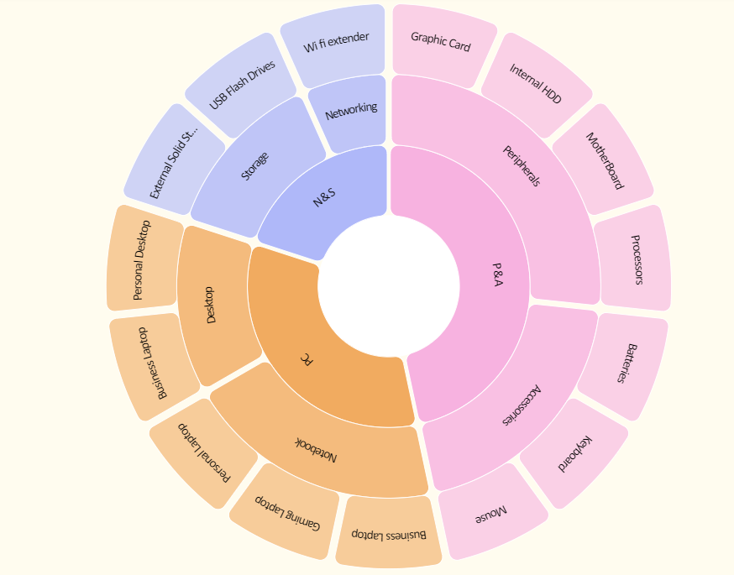

Slide 14
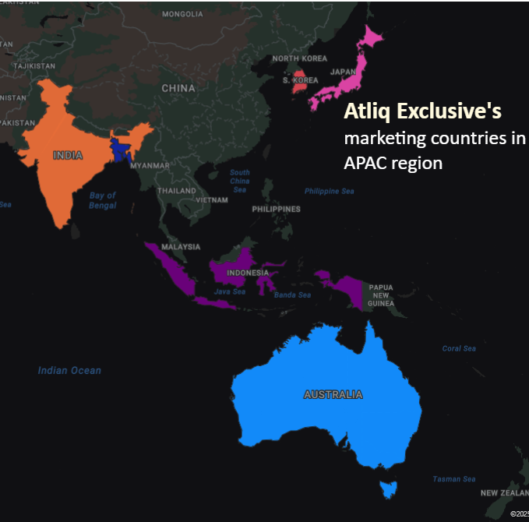

Markets of Atliq Exclusive in APAC Region
01
02
03
04
05
Atliq Exclusive operates in a diverse set of markets across the APAC region, highlighting its broad operational footprint.
The APAC region is a key growth area for AtliQ Exclusive, given its market presence and potential for expansion.
A tailored approach in each APAC market can help strengthen customer relationships and drive sales.
Leveraging data-driven strategies in underperforming APAC markets could unlock significant growth potential..
Partnerships with local distributors and retailers in APAC markets can enhance brand visibility and customer engagement.

Slide 15

Unique Products Overview
2020 Products
245
2021 Products
334
Growth Rate
36.33%
Growth Strategy
Product Expansion: Unique product offerings grew by 36.33% from 2020 to 2021. Focus on sustaining this growth through innovation and diversification in high-performing categories like Accessories and Notebooks.
High-Growth Segments: Desktop segment saw a 214.29% increase in unique products. Expand efforts to cater to the rising demand for Business and Personal Desktops to maximize returns.
Profit Maximization :Networking products have the highest Gross Sales (AVG_GS: $5105.63) and Gross Margin (70.26%). Strategically increase market penetration for premium networking products like Wi-Fi extenders.
Accessory Upselling: The Accessories segment contributes 29.22% of unique product growth with significant demand. Bundle products with higher-margin items to boost revenue.
Focus on Storage Solutions: External Solid-State Drives and USB Flash Drives show strong growth potential (22.06% and 17.65%, respectively). Leverage this demand to drive profitability in Storage solutions.
Balanced Diversification: Maintain a balanced approach by scaling up low-growth segments (e.g., Storage) while strengthening high-margin and high-demand categories.

Slide 16
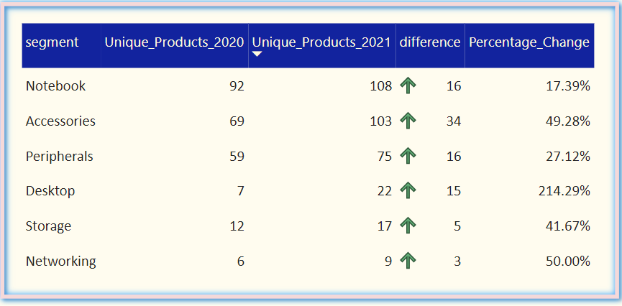

Product Segment Analysis By Year

Slide 17

Product Segments Analysis and Insights
 | Product Count% | Avg MC ($) | Avg GS ($) | Gross Margin Impact | Growth Opportunity
Notebook | 32.49% | 695.49 | 2,323.83 | 70.07% | Expand product variety to maintain leadership.
Accessories | 29.22% | 612.42 | 2047.09 | 70.08% | Leverage popularity to boost premium accessory sales
Peripherals | 21.16% | 560.00 | 1,876.74 | 70.16% | Focus on bundling peripherals for upselling.
Desktop | 8.06% | 878.35 | 2,919.91 | 69.92% | Target enterprise customers for higher sales volume
Storage | 6.80% | 909.70 | 3,024.80 | 70.02% | Promote high-margin storage products for profitability
Networking | 2.27% | 1518.57 | 5,105.63 | 70.26% | Tap into growing demand for networking solutions.

Slide 18
Desktop Segment Growth Potential
Market Opportunity
The desktop segment has experienced over 200% growth indicating strong market demand for new products
01
Product Expansion
Diversifying and increasing the product line can maximise profits in the rapidly growing desktop segment
02
Sales Strategy
Implement targeted marketing efforts to capitalize on the desktop segments significant growth potential
03
Business Desktop and Personal Laptops

Slide 19


Manufacturing Cost Insights
Pros
Cons
Cost Diversity
The portfolio caters to various customer segments from budget to premium markets.
Cost Management
Maintaining a diverse range of costs to complicate effective cost management strategies.
01
01
Higher Margins
The portfolio caters to various customer segments from budget to premium markets.
Pricing Pressure
Low manufacturing cost products may lead to pricing pressure in competitive markets.
02
02

Slide 20
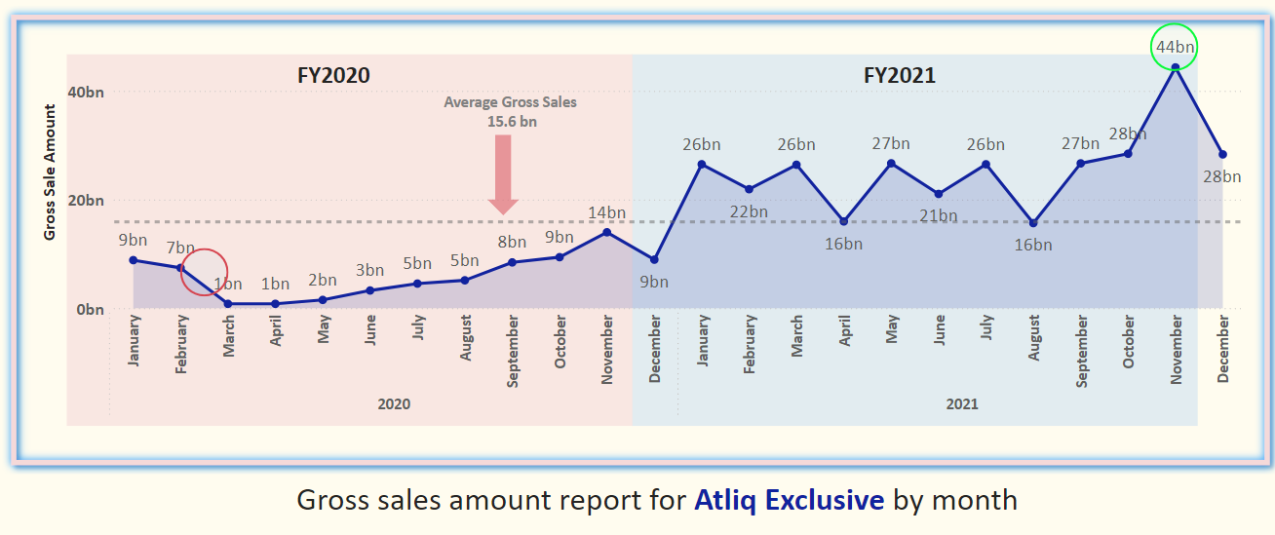
Gross Sales Analysis for Atliq Exclusive

Slide 21
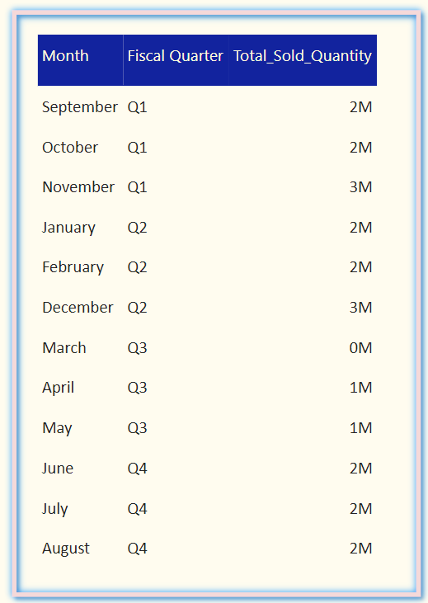
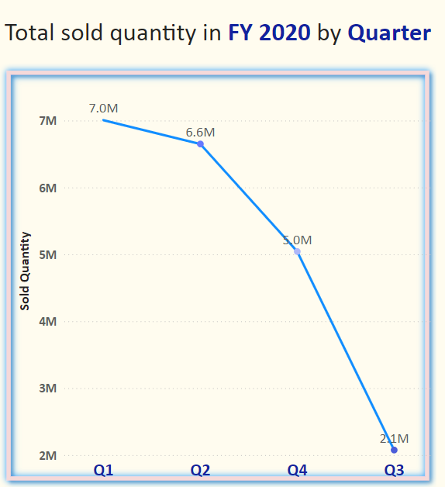
Quarterly Sales Performance Trends

Slide 22
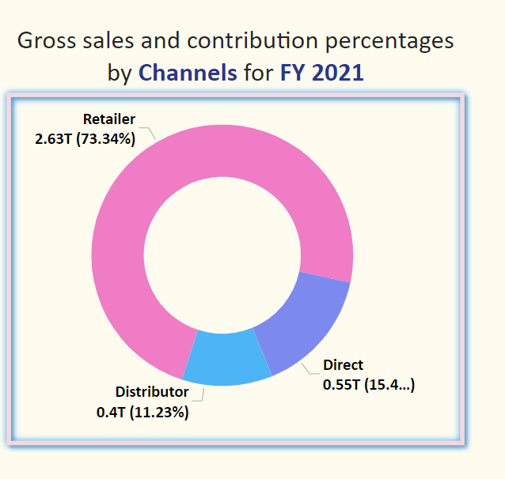
Sales Channels Contribution Overview

Slide 23

Top Customers and Discount Strategies
Monitor
Track discount impact on sales performance regularly.
Explore
Investigate partnership with high-value e-commerce platforms.
01
05
02
Optimize
Revise discount strategies for better profitability.
Communicate
Share discount benefits actively with targeted marketing campaigns
06
03
Segment
Categorise customers based on buying behaviours and discounts
Evaluate
Analyse costs verses returns on discount offerings periodically.
07
04
Negotiate
Discuss better terms with top customers for loyalty
08
Adjust
Be flexible to modify discount rates based on sales trends.
Notes:
High-Cost, Low-Margin Products:
Filters:
Cost per Unit Sold: Top 20% (high cost).
Contribution Margin %: Bottom 20% (low margin).
Strategy Recommendations:
Reduce Production Costs: Explore alternative sourcing for materials or streamline production processes.
Increase Pricing: Gradually increase prices where market conditions allow, particularly for high-demand products.
Discontinue Unprofitable Products: Consider discontinuing products with persistently high costs and low margins.

Slide 24
Top Products Performance By Division
Products by Division
N & S
P &A
PC
AQ Pen Drive DRC
(2.03 M)
AQ Pen Drive 2 IN 1 (0.43 M)
AQ Digit SSD
(0.42 M)
AQ Maxima Ms
(0.84 M)
AQ Gamers Ms
(0.43 M)
AQ Master wireless x1 Ms
(0.42 M)
AQ Aspiron
(17 K )
AQ Digit
(35 k)
AQ Velocity
(17 k)

Slide 25

Enhancing Profitability and Sales
Monitor Focus Products
Prioritize production and marketing efforts towards high-margin, high-volume products like AQ Pen Drive DRC and AQ Lumina Ms to maximize overall profitability.
01
Cost Reduction
Implement cost optimization strategies for high-cost products such as AQ Gamers and AQ Master wired x1 through bulk manufacturing and improved process efficiencies.
02
Targeted Marketing
Enhance sales drives for high-revenue products like AQ BZ 101 and AQ Aspiron through specialized marketing campaigns to capitalize on their revenue potential.
03

Slide 26

Strategic Recommendations and Conclusion
Focus on Product Expansion
Continue evaluating and expanding the Product Portfolio based on market demands
Strategically invest in high- growth segments like Desktops and Accessories.
Optimize Pricing Strategy
Review discount strategies to balance profitability with customer acquisition.
Strengthen relationships with retailers to boost sales through collaboration.
Utilize Data Analytics
Implement advanced analytics to inform strategic decisions on market positioning.
Focus on leveraging peak sales months and improving Q3 performance.

Slide 27

Thank you

